Slide 1

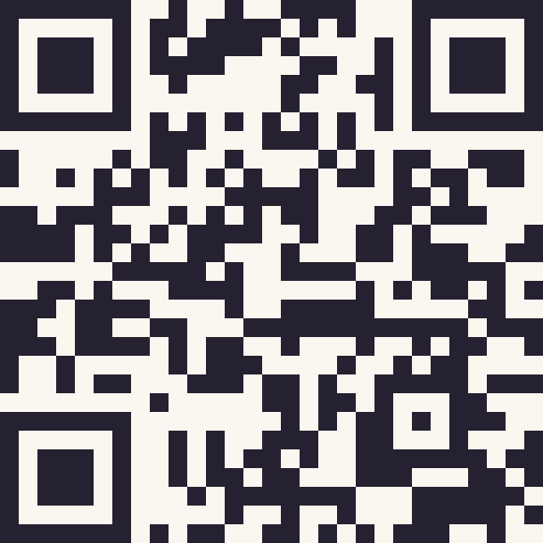
VICTORIAN ELECTION
CANDIDATE FORUMS
Show up. They want to meet you.
Christians belong in the room.
SCAN TO FIND YOUR FORUM
MEETYOURCANDIDATES.ORG.AU
Ask face to face. Keep talking.
The Victorian Election Meet Your Candidate Forums hosted by churches have been supported by Freedom for Faith,
the Christian legal think-tank, seeking to protect the religious freedom of all Australians.
Notes:
Brand reference: https://meetyourcandidates.org.au/
URL artwork extended from the supplied MYC logo with the built-in image-generation tool.

